Slide 1
Requirements for Standards to More Seamlessly Integrate Enterprise AR with Existing IT Systems
5
  Category: Standards
Most Relevant Research Agenda Topics:
https://thearea.org/systems-integration-between-plm-systems-and-ar/
https://thearea.org/area-research-agenda/harmonization-of-standard-industrial-data-with-lightweight-3d-models/

Slide 2
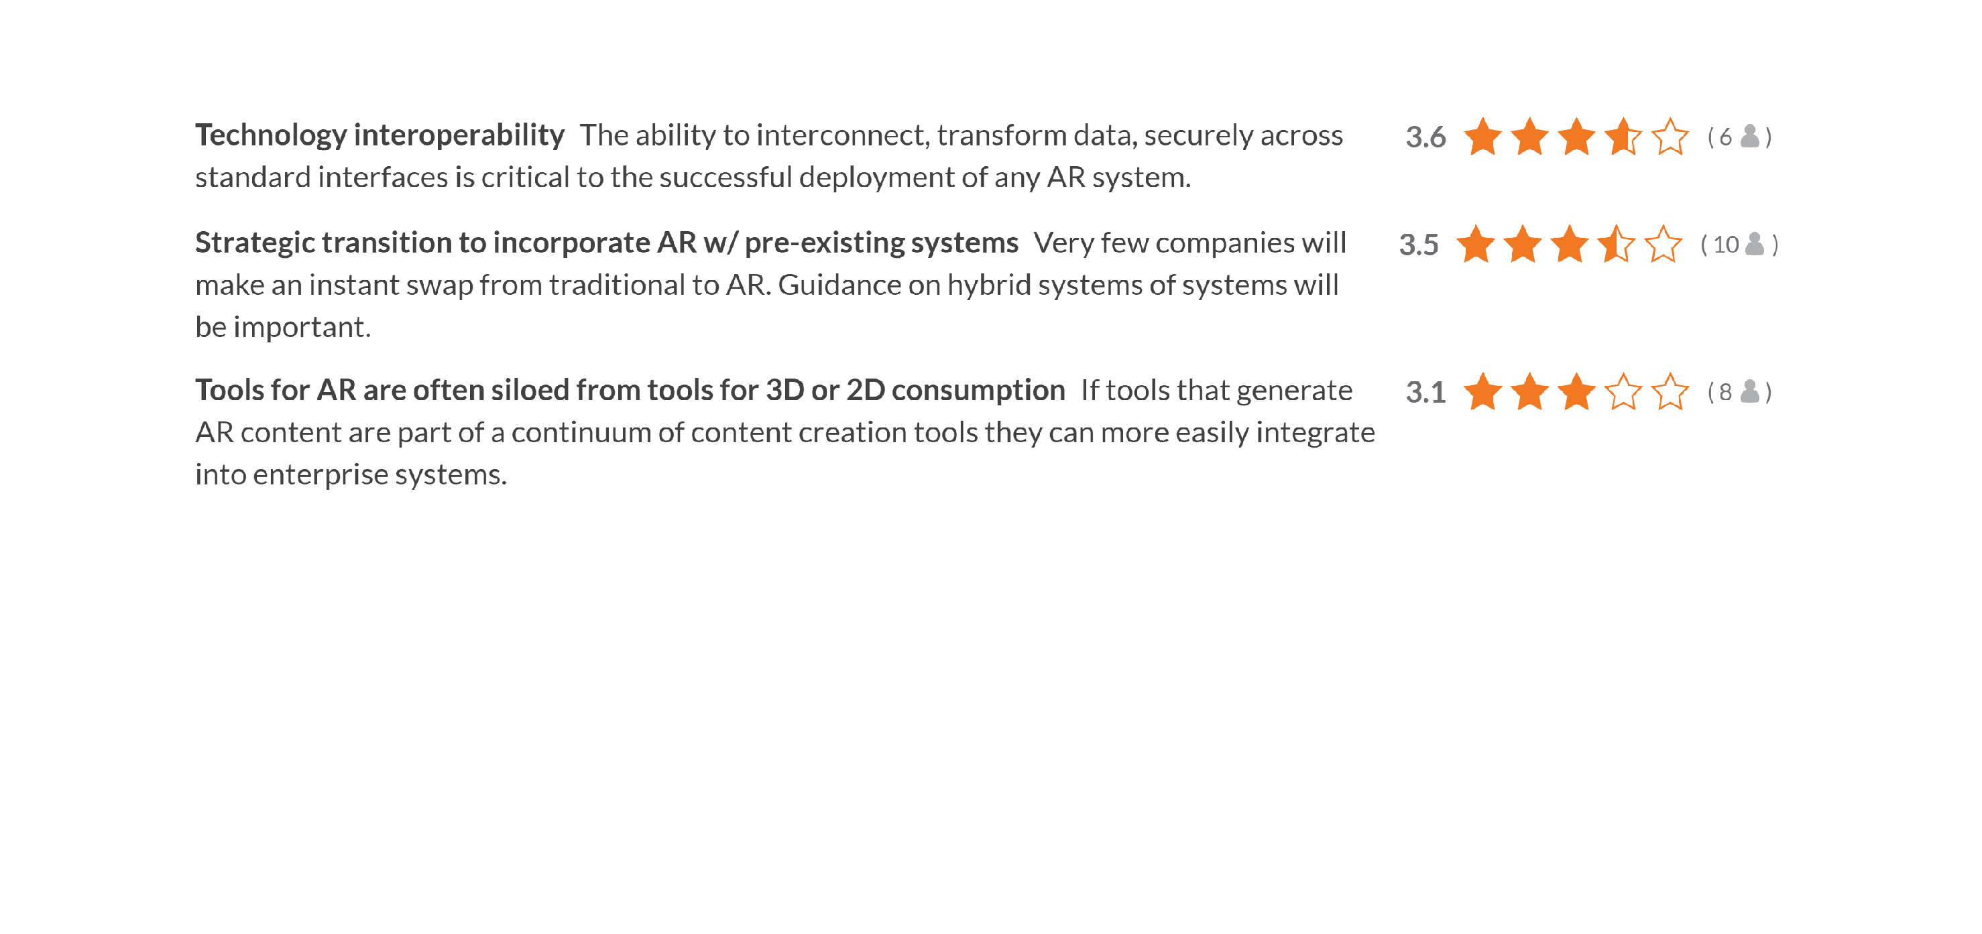

Slide 3
Current Situation
Great Promise and Yet Scale Still Elusive
AR holds great potential with regards to shaping and changing human behavior and subsequently optimizing environments to ensure safe and productive operations
However, it is important to note that the environments above are typically not “greenfield.” They are already supported by an enterprise IT architecture, with existing implementations/partnerships in place with regards to human capital management, knowledge management, operational process/work management, equipment management, etc
If AR is to scale widely across and within organizations, it must integrate with a diverse set of enterprise systems and industry standards and generate meaningful operational and system KPIs in relation to the systems currently in place

Slide 4
Problems this research would address
Sources of information for AR experiences are diverse. Lack of standard interfaces or data encodings often results in no authoritative control of data and/or content before, during and after experience authoring
Systems integration to add AR as a feature of existing IT is expensive and fragile due to highly fragmented tools and inadequate utilization of standards in commercial AR experience authoring/delivery tools and platforms
Some standards exist for data and component interoperability in industrial IT systems but these are often not accessible/in common use
Efforts to extend or to implement existing IT and interoperability standards for AR to meet the needs of enterprise AR ecosystem stakeholders is hampered by lack of a set of clear, objective and well-defined requirements

Slide 5
Possible Questions the Research Answers
What are the key distinguishing characteristics (not the potential benefits) of enterprise AR when it is “seamlessly integrated” with existing IT systems?
Can different levels or stages of AR and IT systems integration be identified and tested for conformity? Is there a maturity model that can guide organizational decisions around roadmaps and future investment?
What are existing (specific and categories of) standards that begin to (or accelerate) the integration of AR with IT systems?
What/where are the gaps in the existing standards and how might they be filled?
Where are the key touchpoints between AR systems and other existing and new technology across the enterprise architecture landscape? What are the ideal data flows and interoperability requirements that would drive scale?

Slide 6
Whose problem would be addressed?
IT groups and enterprise AR project managers would be better prepared to
  Generate informed selection criteria/requirements documentation for future investment in enterprise architecture with correct “hooks” for AR deployment
  Collaborate with existing “application owners” in the enterprise to create and drive implementation roadmaps, as well as manage dependencies
  Increase integration of AR with existing IT systems so that authoring tools, display/interaction devices and content for AR experiences are managed under/by a single set of IT policies and procedures
  Contribute to, evaluate and provide feedback to standards organizations about requirements they have for AR integration with existing IT systems
Providers of enterprise AR software/platform companies would be able
  To begin or finish implementation of international data interoperability standards for integrating AR into existing IT systems, and/or
  Adopt standards identified in this study and promote how they are able to lower the risk and costs facing customers seeking to introduce AR at scale
  Confidently and competitively respond to enterprise RFIs and RFPs and resulting requirements documentation from enterprise sponsors and stakeholders

Slide 7
How would this research be conducted?
With AREA member input, choose one or more use cases in a specific industry where AR adoption at scale is being held back by lack of integration with domain-specific IT, engineering, operation, knowledge/content, and human capital management systems
Define key touchpoints and ideal data flows between systems above
Perform desk research about standards that will meet the enterprise AR and IT requirements and document any data formats and standards available
Compare interfaces (e.g. APIs) and logical models in existing standards used by the industry (domain) for suitability to add AR as a feature
Prepare a gap analysis, define interoperability requirements and develop a set of recommendations for future work in enterprises and standards organizations

Slide 8
Deliverables of this project
Schematic/diagram indicating relevant portions of enterprise architecture, their touchpoints with AR systems, and desired data flows therein
An annotated table (spreadsheet) of specifications pertaining to existing IT systems and technologies in use in the selected industry (domain) today
Analysis of how/where AR experience authoring and delivery tools can benefit from adoption of the existing and emerging IT and interoperability standards
Report containing a gap analysis, specific (and testable) interoperability requirements for existing and future standards development, a set of recommendations for future work in enterprises and standards organizations, and a potential progression/maturity model to inform future investment/roadmaps
Executive summary of findings for public release and a webinar

Slide 9
Benefits to AREA members
Concise catalogue of potential touchpoints, processes and data flows between AR systems and existing enterprise architecture
Recommended practices for implementation of existing standards available for integrating enterprise AR components, systems and technologies with existing IT systems
A rich and well-informed public advocacy program for the adoption of existing standards that could reduce fragmentation and increase the return on investment when implementing AR at scale
Lower cost of ownership and operations as a result of being able to reduce conflicts and increase manageability of content being used in AR experiences and captured when AR systems are in use, and use of common data APIs and protocols across enterprise operations
Maturity model to help inform future roadmaps and required investment to drive scalability

